Slide 1
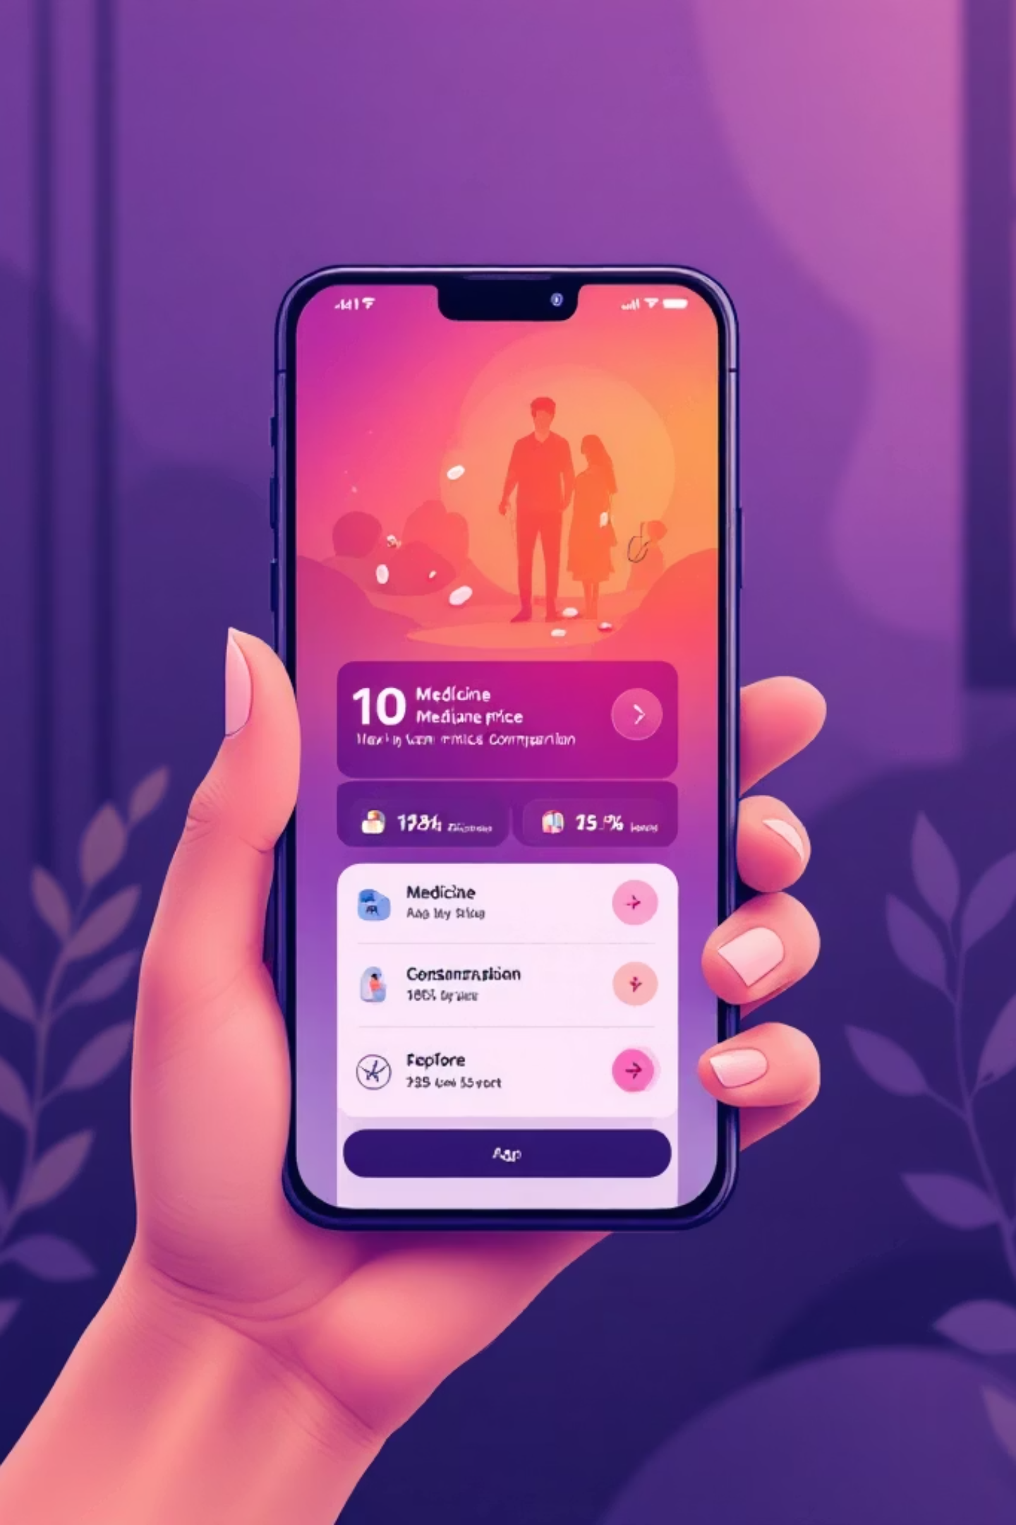
MedFinder 💊
Save Up to 70% on Your Prescriptions
Making healthcare affordable for every Indian family — fast price comparisons, trusted generics, and AI alerts that protect budgets and health.

Slide 2
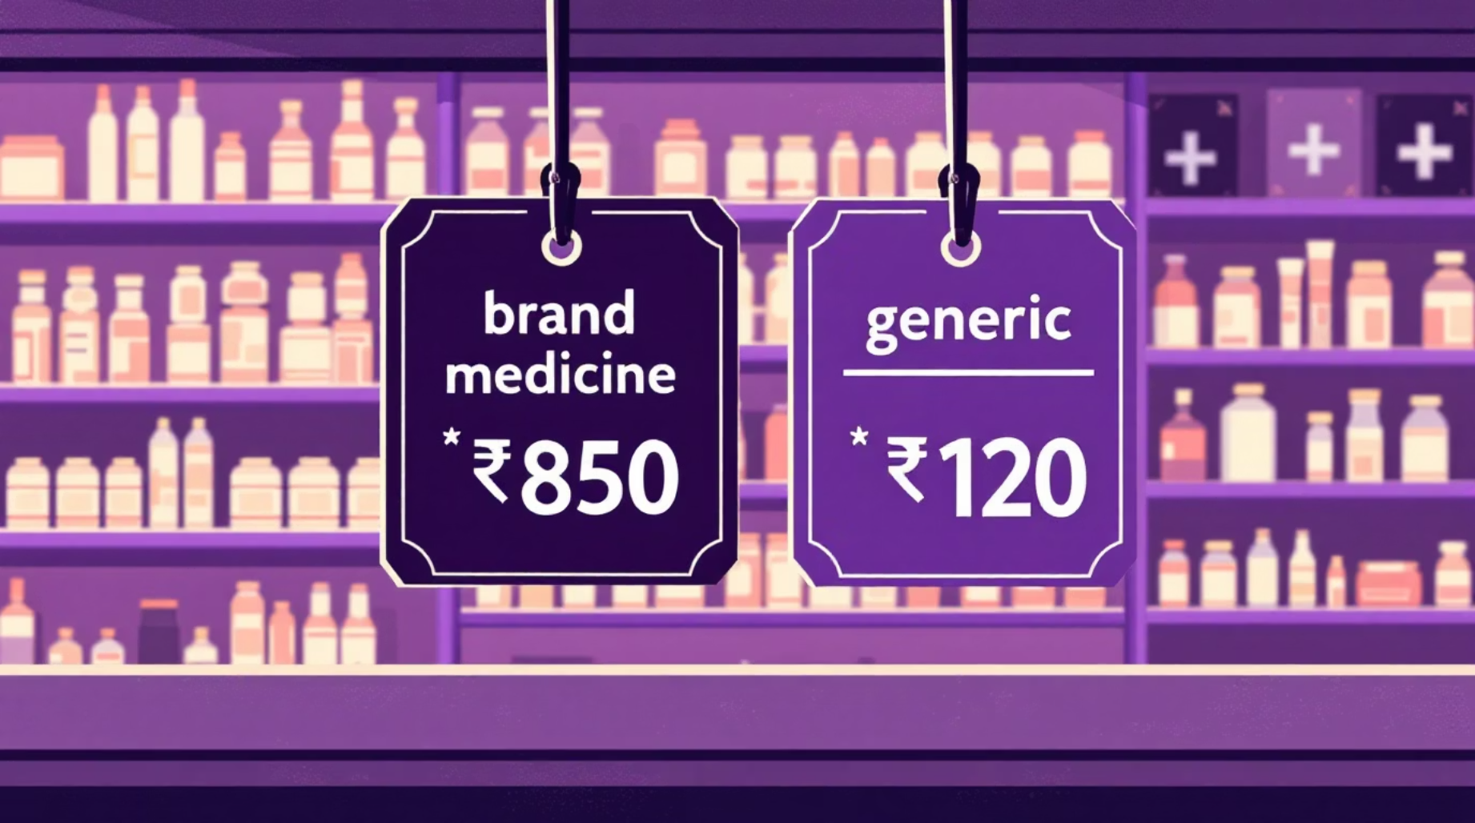
The Healthcare Affordability Crisis
What families face
Indians often overpay up to 300% for brand medicines. Many low-income households skip or ration doses because prices are unaffordable.
Transparency gaps
Prices vary widely between pharmacies; generic alternatives and savings are often unknown to patients and caregivers.
Real-world example
Diabetic patient paid ₹850 for Lisinopril brand vs generic at ₹120 — a savings of ₹730 (≈ one week of groceries for a family).
Impact: ₹730 saved = 1 week of groceries for an average family. Cost barriers directly harm adherence and outcomes.

Slide 3






MedFinder: Your Medicine Price Companion
Scan Prescriptions 📸
Compare Prices 💰
AI Price Predictions 🤖
One-tap Navigation 🗺️
Live comparisons across 100+ pharmacies with generics highlighted and verified prices.
Instant OCR converts handwritten or printed scripts to searchable drug names.
Predicts short-term price drops and recommends the best purchase time.
Directions to the cheapest in-stock pharmacy with estimated travel time.
Track Lifetime Savings 💾
Price Drop Alerts 🔔
Personal savings dashboard shows cumulative impact for families.
Automated alerts for favored medicines and nearby stock updates.
Find the best price in under 2 minutes — empowering caregivers to choose affordable, safe options.

Slide 4

Impact & Proof
Testimonials
"Saved ₹730 on diabetes medication — that's my weekly grocery budget!" — Rajesh Kumar, Delhi
"Found generic for mother's heart medicine. Saved ₹920!" — Priya Sharma, Mumbai
Social return: We reduce financial strain and improve adherence — measurable health and economic benefits for families.
👨‍👩‍👧‍👦 10,000+ Families Helped
💰 ₹2.85 Crores Saved
📊 68% Average Savings
Verified user outreach across 25+ cities
Total documented savings since launch
Per prescription when generics and lowest-price options are used

Slide 5
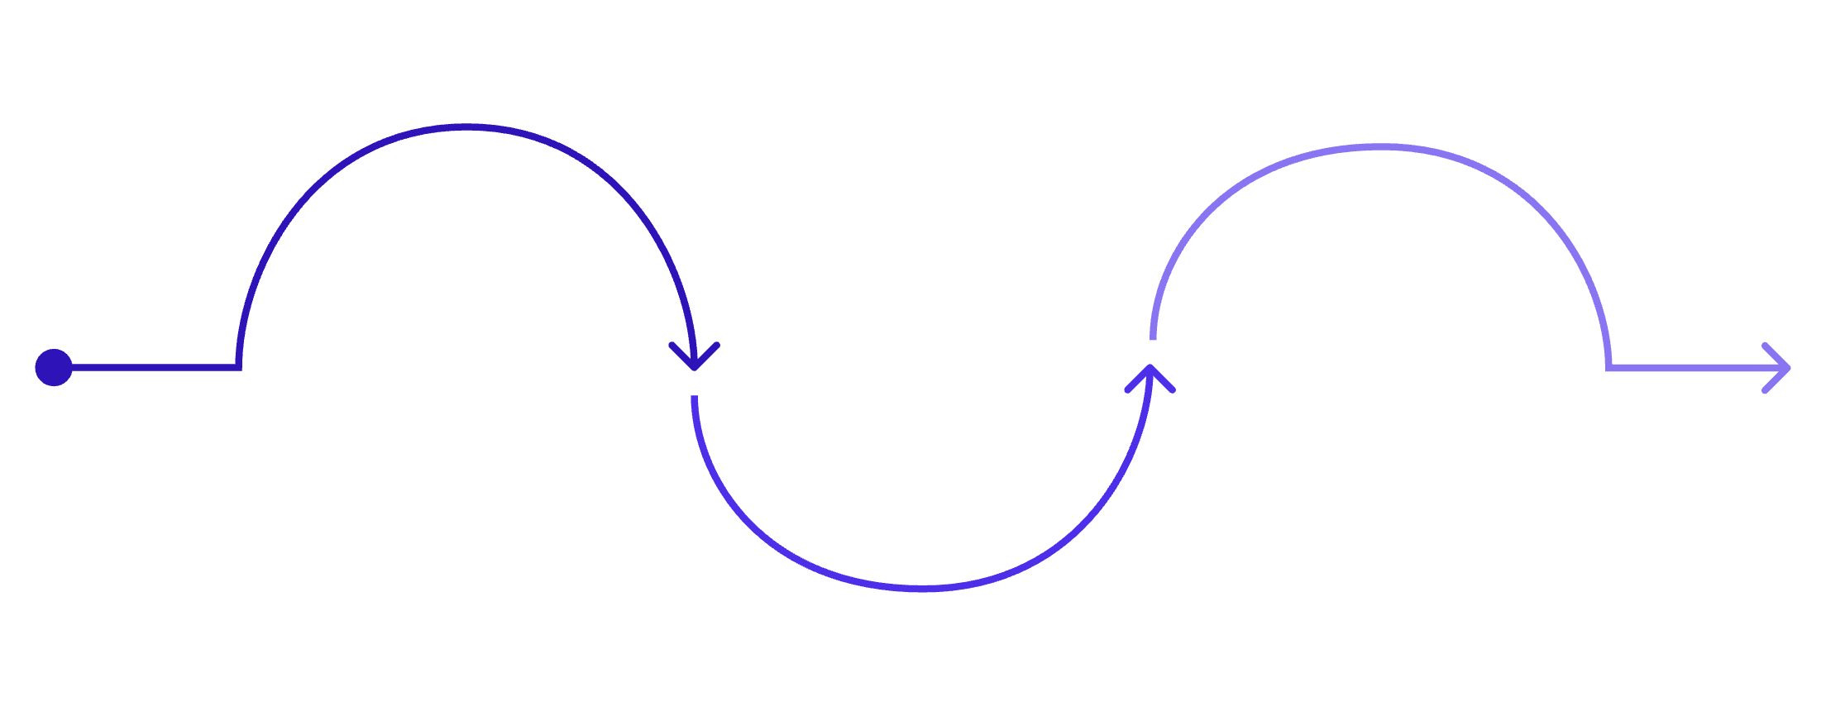
Path to Scale — Technology, Model & Roadmap
Roadmap (12 months)
Tech & Ops
FastAPI • Next.js • React Native • Tesseract OCR • AI price models • Real-time ingestion • Google Maps
Phase 1
Phase 3
3 months: voice search, 50+ cities, multilingual
Phase 2
12 months: pan-India, wearables, blockchain prescriptions
6 months: telemedicine, insurance claims, rewards
Revenue Streams
Pharmacy partnerships (referral commissions)
Premium subscriptions (₹99/month)
Insurance & hospital integrations (B2B)
Enterprise features for hospitals
Vision: Make healthcare affordable for 100 million Indians. Target: 1M users Year 1; expand to 500+ cities and enterprise partnerships.
Join us: MedFinder is more than an app — it's a movement so no family chooses between medicine and meals.

